Slide 1
GreenQQ Interface Proposal

Slide 2
Objectives
Make the interface work with GreenQQ “as is”
  Ideally, no code modifications should be required.
  Inevitably, however, there will be some – hopefully minimal.
  The post-mockup comments at the end point out what I think is needed.
  Other comments at the end point out remaining/auxiliary issues that should be addressed.
Make the interface record-based
  Currently, GreenQQ classifies (and thus extracts) named entities and groups them into records (i.e. groups of named entities falling textually between entities specified as belonging to a designated primary class, e.g. “HEAD”)
  GreenQQ does not find/discover/recognize/extract within-record relationships, but since it does group entities into records, it can treat every extracted named entity within a record as a property of the object the record represents. Thus, GreenQQ currently can (already does) extract relationships between the record’s object and its extracted named entities.
  It’s the responsibility of users to design records so that the relationships they wish to capture satisfy these constraints. (Examples: an organization record could have an organization name, officers, members, a statement of purpose, … but not inter-relationships among officers and members; a country record could have a name, capital city, population, type of government, states, cities, … but not relationships such as capital cities of states; a family can have parents and children that belong to the family, but not birthdates of individuals within the family.)
  GreenQQ can process multiple records (one at a time) which when the results are taken together can find/discover/recognize/extract rich relationships among the various objects and object properties. (Examples: a manager/underling record to go along with an organization record; a state/capitalCity record to go along with a country record; and a person/birthdate record to go along with a family record.)

Slide 3
GreenQQ Step 1: Specify the Classes
Notes:
This “Form Builder” is already implemented. The “Add a Form” button adds another form to the collection. The “>” next to each field, when clicked, lets a user nest form fields of various kinds under the field.
Here I have defined three form/record templates: Person, Couple, and Family. These are the record definitions for GreenQQ. Each one corresponds one-to-one with the mini-ontologies in Figures 7, 8, and 9 of the emisa paper. The red asterisk specifies the grouping class for the record (i.e. the “HEAD” class). It’s also the field for ontological commitment which you can read more about in the emisa paper, but essentially it means that when the text for this class is recognized/extracted, a record-object is instantiated.
The classes specified for GreenQQ are the leaf-level field names. (In general, further nesting is possible, e.g. under BirthDate we could nest BirthDay, BirthMonth, BirthYear, in which case BirthDay, BirthMonth, and BirthYear would be class names while BirthDate would then not be a class name.)

Slide 4
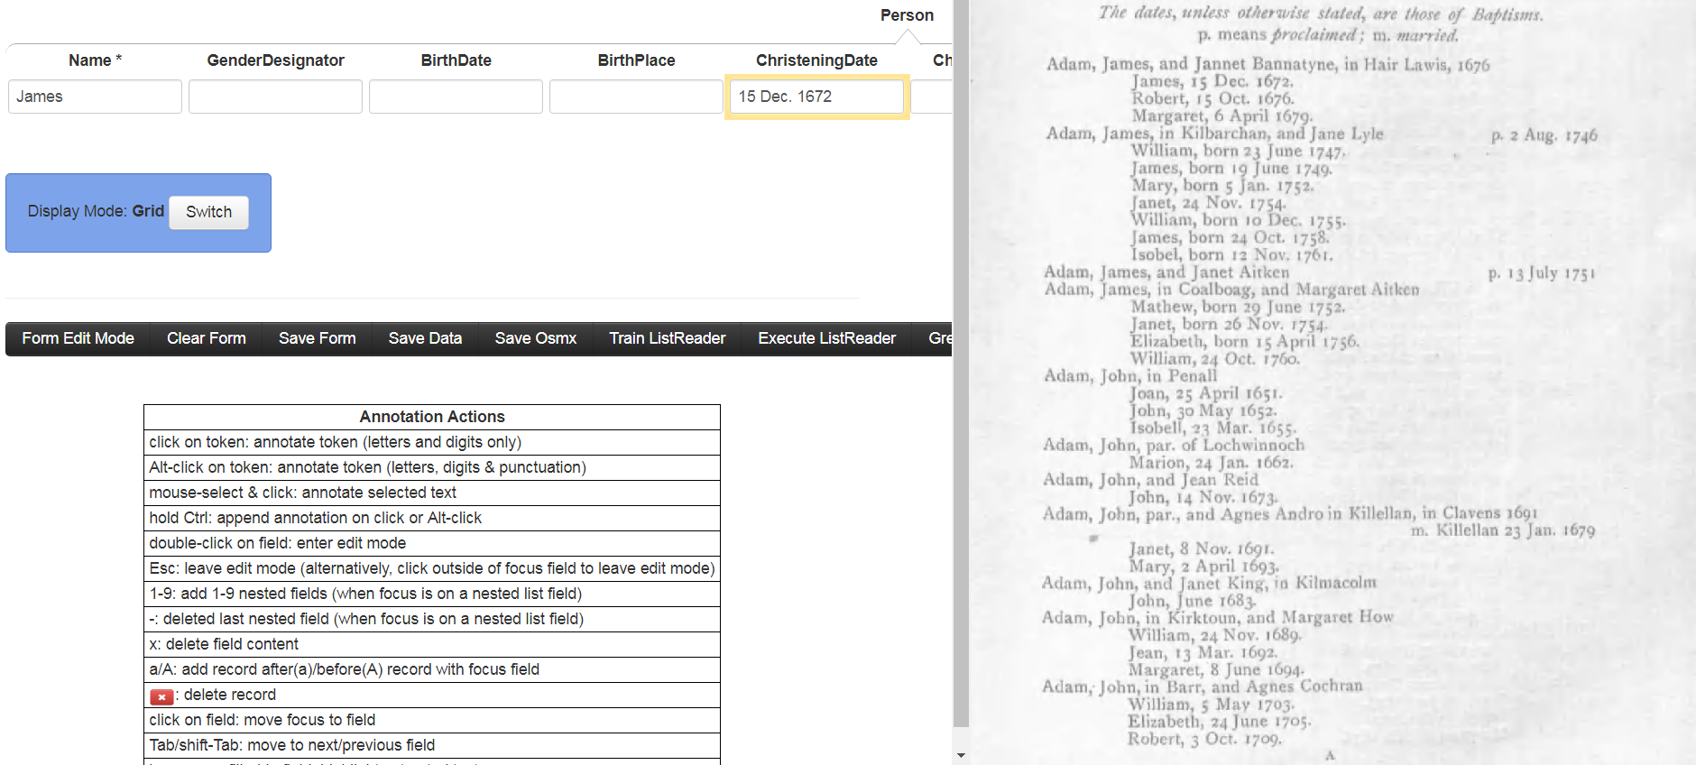
GreenQQ Step 2: Create Rules
CAP , ANUM CAP . ANUM . ELINE
Run
Save
Notes:
This step builds on the already implemented COMET interface. The Annotation Actions explain how to use COMET. For example with the focus (yellow outline) on a Name box, a click on James is all that’s required to fill in the field; and with the focus on the ChristeningDate field (as in the mocked-up screenshot), while holding Ctrl, a click on 15, an Alt-click on Dec., and a click on 1672 fills in the field with 15 Dec. 1672. (Holding Ctrl keeps the focus on the same field; without holding the focus moves to the next field.)
The proposed addition to COMET for GreenQQ rule creation are these form-filling actions – and that’s all it takes! In the screen shot above the user has just made the three clicks to enter 15 Dec. 1672 and clicked on Run – nothing else! In this mode of operation, GreenQQ at this point creates the template shown (extract in green letters, context in black letters) and executes it on the page highlighting all instances it recognizes. (In the mock-up, the single click action to create the rule for James has already been executed and the rule saved.) Before saving a rule, the user can edit the rule. (The next slide shows a continuation of this example in which there is an edit.)

Slide 5
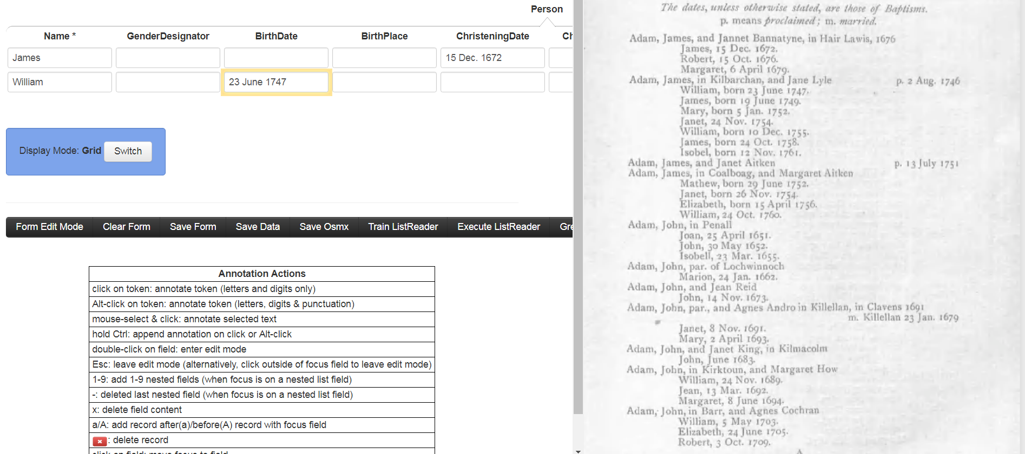
GreenQQ Step 2: Create Rules
born ANUM CAP ANUM . ELINE
Run
Save
Notes:
The mocked-up screenshot here is taken just after a user-edit changing LWRC to “born”. (I’m guessing that LWRC is the tag for lower-case words.) It’s red because this now also becomes a literal (LIT born). Also, prior to changing LRWC to “born”, the user would have removed the “,” which would have been the first token in the template assuming -2/+2 for context (my default in these examples, which can be set/changed by the user). I am also assuming that a rule for Name: William was created by editing the default “ELINE SLINE CAP , LRWC” to be “SLINE CAP , born”, in which the first token ELINE was removed and LRWC was changed to “born”. (The “born” here would also have been red. The way to create a literal is to replace an abstract tag with text. And, BTW, in the BirthDate example here, the user would not have had to change LWRC to “born” because GreenQQ would already have it recorded as a literal from the change to “born” when creating the rule for William.) Another example of creating a LIT would be to change “LRWC . CAP ANUM CAP” (for “m. Killellan 23 Jan. 1679” in the page) to “SLINE m. CAP ANUM CAP” where “m.” would be red and would generate “LIT m.”. Here, I replaced two tokens LRWC and “.” with “m.”. And I added SLINE to exemplify that we can also expand context.
Users will need a key for tag names, e.g. CAP = Capitalized Word, ANUM = All Numeric, … . Presumably, it would be in the interface or accessible with a click, but I do not show it.

Slide 6
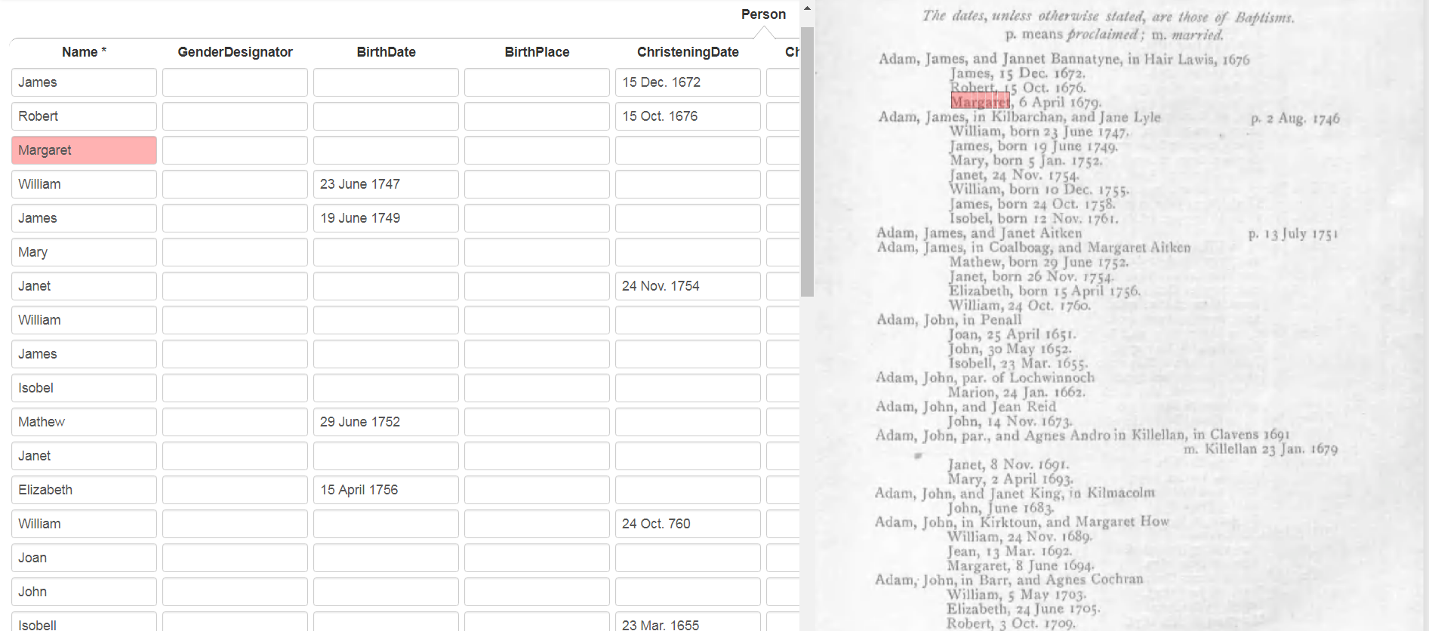
GreenQQ Step 2: Create Rules (check rule set)
Notes:
Instead of just executing the current rule being developed, the entire rule set can be executed. In our example, when we execute the four rule templates so far in our rule set, we obtain the results above with all the names of the babies (some hidden below the end of the screen) along with BirthDates with non-abbreviated months and ChristeningDates with abbreviated months. (Depending on how we tokenize, we might have been able to get all the BirthDates and ChristeningDates (except’s John’s June 1683 birth date which is missing a day). See my Post Mock-up Comments about tokenization.) This display feature of COMET is already implemented. Hovering over a record highlights both the fields in a record and the text extracted on the page for each field. In the screenshot above the mouse is hovering over the highlighted Margaret record. This makes it easy for a user to scan down the records and see what’s correct, incorrect, incomplete, and missing.
At this point, the user could return to the rule-creation mode and add the additional rules still needed to capture all the Person information for the page. See next slide.

Slide 7
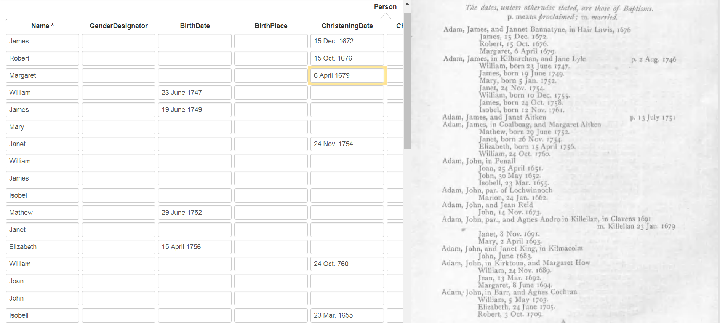
GreenQQ Step 2: Create Rules (check rule set)
CAP , ANUM CAP ANUM . ELINE
Run
Save
Notes:
Note that this rule is created by simply entering the ChristeningDate – no editing is necessary. The same holds true for adding the rule for BirthDates with abbreviated months. A separate rule would be needed for John’s day-missing BirthDate, but it too can be created just by entering “June 1683” in his ChristeningDate field.
After creating these rule and checking the rule set, the user would likely be ready for the next step – working with GreenQQ-generated candidate rules. Thinking ahead, an astute user might believe that GreenQQ would probably generate all the rules needed as candidates after having created just the first two. Users need not wait until the have perfect results for a page; they can begin iterating as soon as they wish. Also, while iterating they can return to initial rule creation and go back and forth as desired.

Slide 8
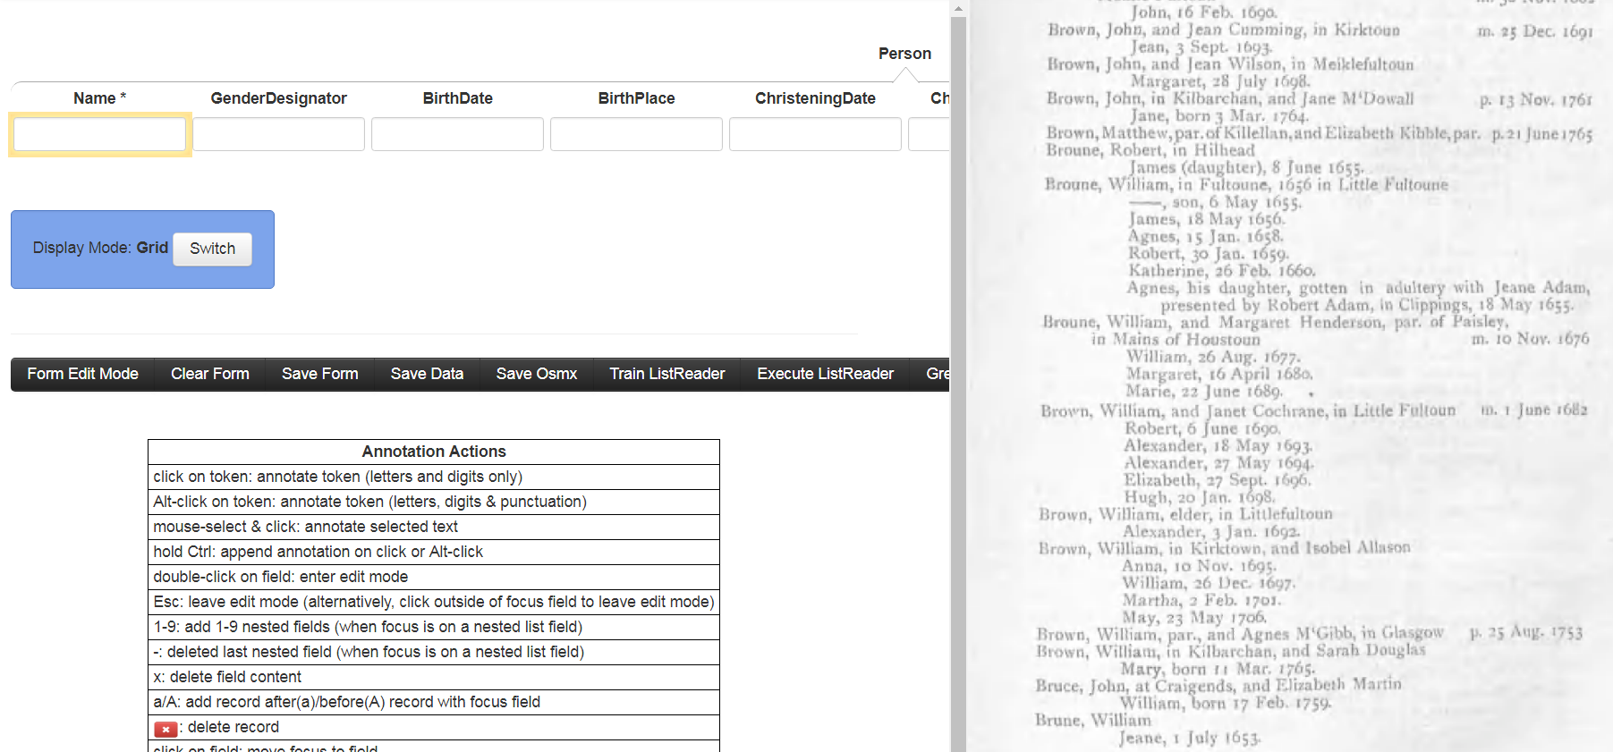
GreenQQ Step 3: Edit Candidate Rules
1523
Name
. ANUM ELINE SLINE CAP , CAP , LWRC CAP , LWRC CAP
>
Make
Dismiss
48
Name
CAP . ANUM . ELINE SLINE CAP , CAP ELINE SLINE CAP ,
>
Make
Dismiss
19
Name
CAP . ANUM . ELINE SLINE CAP LWRC CAP , born ANUM CAP
>
Make
Dismiss
18
Name
CAP , LWRC CAP ELINE SLINE CAP ( LWRC ) , ANUM CAP
>
Make
Dismiss
Notes:
GreenQQ generates n candidate rules (here just 4) and sorts them according to frequency of pattern occurrence. It also picks a page on which the highest frequency pattern appears and among the many of the possibilities, a page that has a maximum number of other patterns. For each rule whose pattern appears on the page, GreenQQ picks an example, highlights the text and highlights the extract with green box. Rules whose pattern is not on the page have no highlighting. Clicking on an non-highlighted “>” causes the system to display the referenced page and highlight the text and extract for the rule and also for any other rule whose pattern matches text on the page.
A user can choose to Make or Dismiss rules as desired, in any order. Dismissing a rule removes it from the list; it also stores the rule in a dismissed list so that in subsequent iterations the rule will not be presented to the user as a candidate rule. In this example, the first two rules should be dismissed since they do not identify Names that belong to Person records (i.e. neither the highlighted William nor the highlighted Brune have any associated birth or death information). Clicking on Make for a rule causes a mode change to the rule creation display. In doing so, it also fills in a form record with the extract. If the rule is what’s wanted, a simple click on save is all that’s necessary to complete the making of a new rule. Otherwise, the user can edit, test, and save the rule as previously explained. The next slide gives an example for the GreenQQ “James (daughter)” candidate rule.

Slide 9
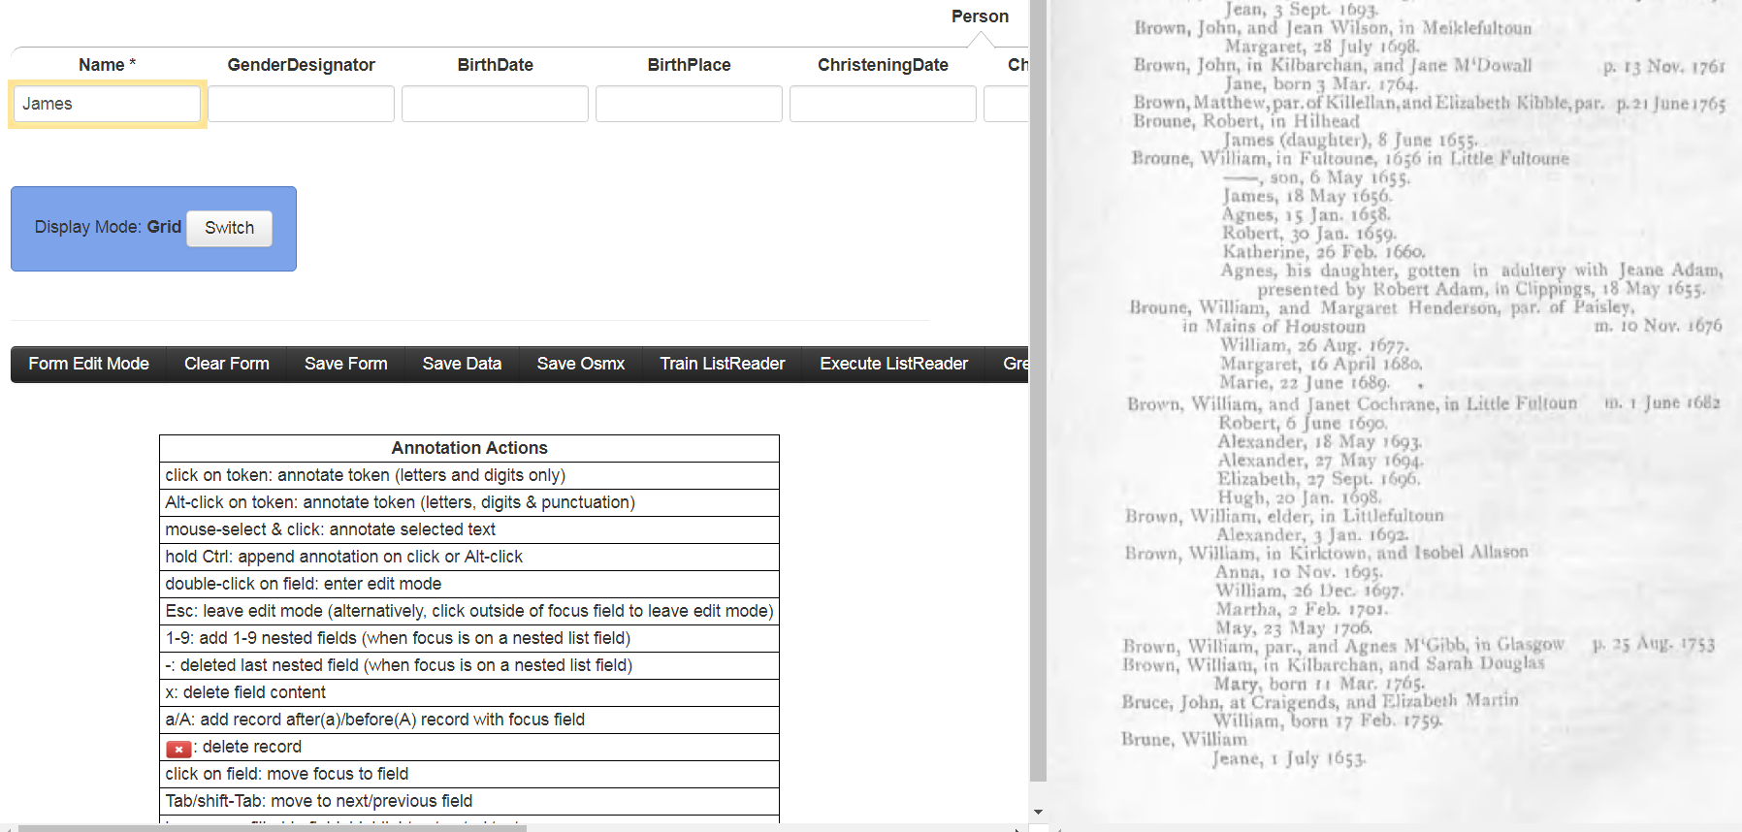
GreenQQ Step 3: Edit Candidate Rules
SLINE CAP ( LWRC ) , ANUM
Run
Save
Notes:
The mock-up shows the state after editing and clicking on Run. The user actions to get here comprised: (1) clicking on Make for the rule in the previous slide (resulting in the rule being displayed AND James being filled into the Name field), (2) editing to remove CAP , LWRC CAP ELINE from the beginning of the rule and CAP from the end, and (3) clicking on Run to highlight James on the page. The user can now Save the rule. Note that the editing generalizes the rule so that it does not require a previous line ending in CAP , LWRC CAP ELINE and that leaving LWRC in parentheses also lets this pattern extract other names followed by a parenthesized word, e.g. “(natural)” or “(posthumous)”.
Now, a user should recognize that the GenderDesignator field should also be filled in as well as the ChristeningDate. As before, the user could ask for the full rule set to be executed on the page to help discover that rules for GenderDesignator and ChristeningDate do not already exist. While in this mode, all the facilities of the mode are available to the user. In fact this is the only mode in which rules are created. The next slide shows a mock-up screenshot for adding these two additional rules.

Slide 10
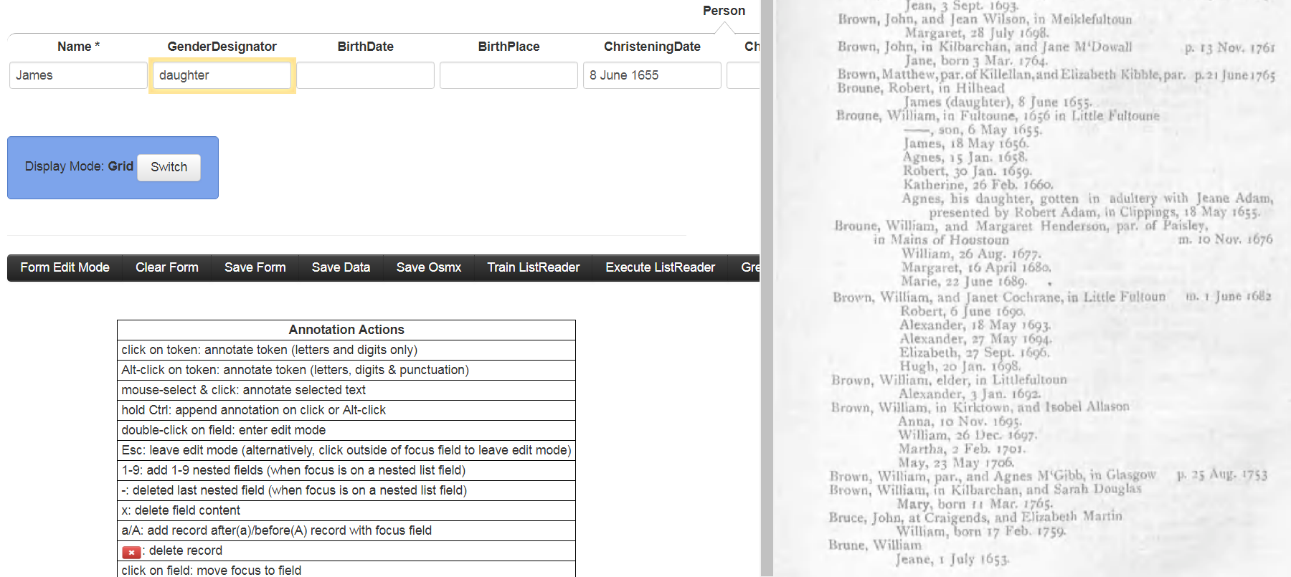
GreenQQ Step 3: Edit Candidate Rules
CAP ( daughter )
Run
Save
Notes:
The state of the system here assumes the following. The user has first filled in the ChristeningDate with “8 June 1655” and edited the default pattern appropriately, as illustrated earlier. The user has next extracted “daughter” into the GenderDesignator field, which generated the default template “CAP ( LWRC ) ,” and then removed the trailing comma and replaced the green LWRC with the green “daughter”. (This also adds “LIT daughter”. Context literals are red; extract literals are green.) Finally, the user has clicked on Run to highlight daughter in the page. The user can now Save the rule and continue creating rules.
When done with the create-rules mode of operation, the user can return to processing candidate rules. Alternatively, the user can ask GreenQQ to generate a new set of candidate rules for another round of processing. (This request can also be made from the candidate rule processing mode.) The next slide illustrates a return to processing the current list of candidate rules.

Slide 11

GreenQQ Step 3: Edit Candidate Rules
19
Name
CAP . ANUM . ELINE SLINE CAP LWRC CAP , born ANUM CAP
>
Make
Dismiss
Notes:
On return the user has clicked on the “>” for the rule, which displays a page on which the rule template recognizes some text. Note that the dismissed candidate rules and the candidate rules edited to be extraction rules no longer appear on the list of candidate rules.
At this point, the user can click on Make and create two rules, one for the first twin “SLINE CAP and CAP , born” (with the first CAP green, as it already was, and “and” in red along with “born” which was already red because it had been earlier designated as a LIT) and one for the second twin “and CAP , born” with CAP green and “and” and “born” red.

Slide 12
Post Mock-up Comments (foreseen code changes)
Allow users to define record groups that can be processed sequentially as a unit without user intervention. (E.g. allow Person, Couple, and Family to be executed sequentially as a unit rather than having to invoke each one individually.)
Overlapping rules should be OK, possibly with some restrictions. (You’re already doing this – right?)
Create a dismissed rule list to prevent GreenQQ from regenerating dismissed rules on subsequent iterations.
Records may overlap on a page (see emisa example for Couple in the GreenQQ section). In this case, we either need to find a way to automatically partition rules for the record group or allow a user to specify the partition. These rule partitions would then be run sequentially along with the other sequential executions.
Depending on whether we can make nltk tag text as we wish, we may need to do our own tagging. Both “Jan.” and “Mar.” should be “CAP .”
If user edits cause a template to be syntactically incorrect, we’ll return an error message. If the template is semantically incorrect, the user will have to discover this by testing the rule.

Slide 13
Post Mock-up Comments (ideas for future work)
Picking ideal pages for a user shouldn’t be too hard to add by just keeping page lists for every candidate and intersecting the lists. Choosing a good first page to work on could be done by selecting a page with the most prominent and greatest variety of ListReader-recognized record patterns.
OCR errors in literals should not cause problems (e.g. “bom” for “born” is just another pattern). OCR errors in tagged words are problematic. COMET lets us edit a word to fix an OCR error. So, for instance, if a user changes “jonet” to “Jonet”, the system (or user) could edit LWRC in a rule to be “(CAP, jonet)”, which would generate “CAP jonet” as seen in your initial Kilbarchan rules and change LWRC to CAP in the rule.
We may need to allow users to edit saved rules. They may, for example, want to tighten or loosen the context of a rule, or they may need to resolve an ambiguity (e.g. a rule that recognizes dates that are sometimes christening dates and sometimes birth dates), or …
Cross-page rules should be allowed.

